Slide 1
Getting Set Up

Slide 2
Installation Checklist
Use a hosted environment (requires subscription) OR
Install Anaconda
▫ Open up an Anaconda command prompt
▫ conda install pydotplus
▫ pip install tensorflow
Download course materials from www.sundog-education.com/machine- learning

Slide 3
Python Basics

Slide 4

Let’s just jump right into some code.

Slide 5
Types of Data
Presented by Frank Kane

Slide 6

Many Flavors of Data

Slide 7
Major Types of Data
Numerical
Categorical
Ordinal

Slide 8
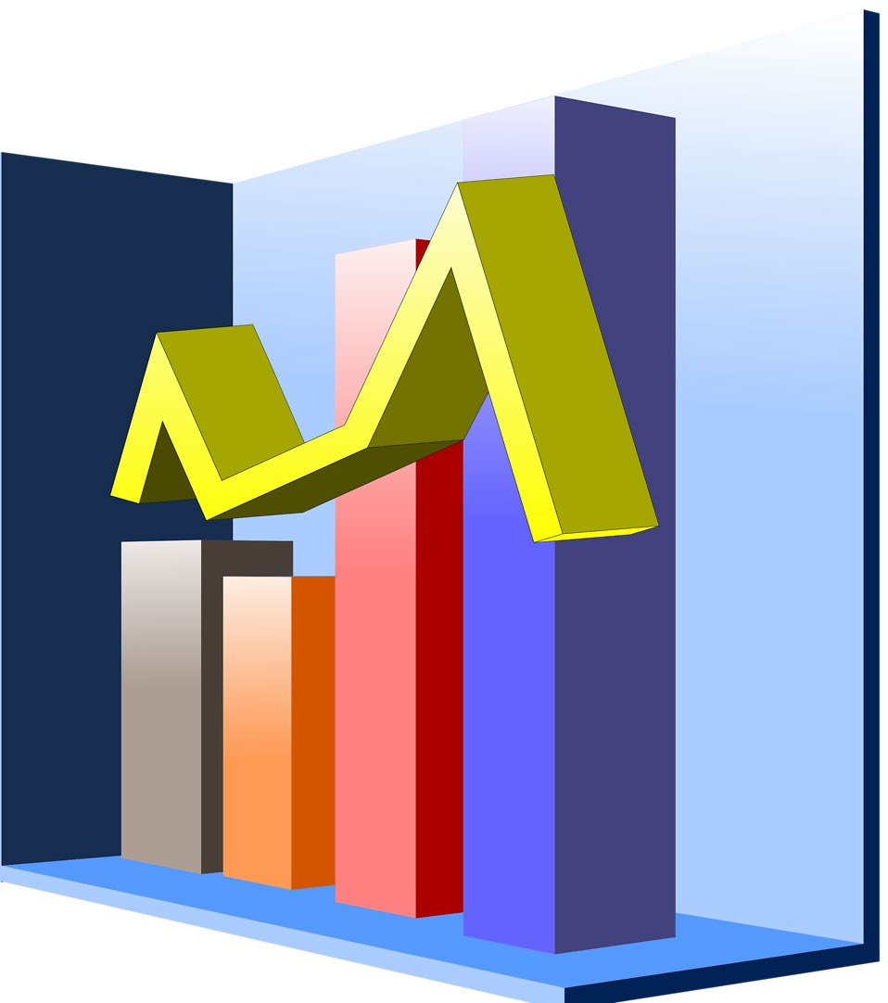
Numerical
Represents some sort of quantitative measurement
▫ Heights of people, page load times, stock prices, etc.
Discrete Data
▫ Integer based; often counts of some event.
🞄 How many purchases did a customer make in a year?
🞄 How many times did I flip “heads”?
Continuous Data
▫ Has an infinite number of possible values
🞄 How much time did it take for a user to check out?
🞄 How much rain fell on a given day?

Slide 9
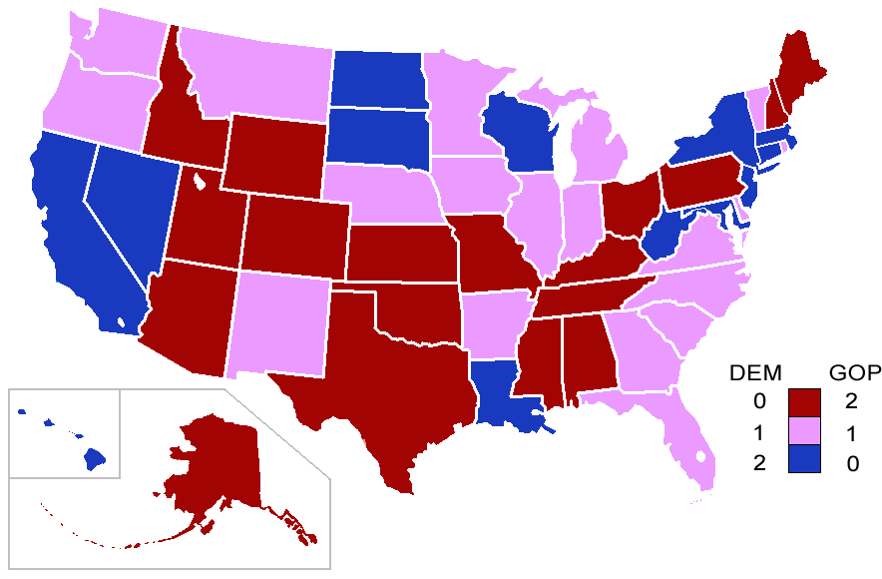
Categorical
Qualitative data that has no inherent mathematical meaning
▫ Gender, Yes/no (binary data), Race, State of Residence, Product Category, Political Party, etc.
You can assign numbers to categories in order to represent them more compactly, but the numbers don’t have mathematical meaning

Slide 10

Ordinal
A mixture of numerical and categorical
Categorical data that has mathematical meaning
Example: movie ratings on a 1-5 scale.
▫ Ratings must be 1, 2, 3, 4, or 5
▫ But these values have mathematical meaning; 1 means it’s a worse movie than a 2.

Slide 11

Quiz time!
Are the following types of data numerical, categorical, or ordinal?
▫ How much gas is in your gas tank
▫ A rating of your overall health where the choices are 1, 2, 3, or 4, corresponding to “poor”, “moderate”, “good”, and “excellent”
▫ The races of your classmates
▫ Ages in years
▫ Money spent in a store

Slide 12
Mean, Median, and Mode

Slide 13
Mean
AKA Average
Sum / number of samples
Example:
▫ Number of children in each house on my street:
0, 2, 3, 2, 1, 0, 0, 2, 0
The MEAN is (0+2+3+2+1+0+0+2+0) / 9 = 1.11

Slide 14
Median
Sort the values, and take the value at the midpoint.
Example:
0, 2, 3, 2, 1, 0, 0, 2, 0
Sort it:
0, 0, 0, 0, 1, 2, 2, 2, 3

Slide 15

Median
If you have an even number of samples, take the average of the two in the middle.
Median is less susceptible to outliers than the mean
▫ Example: mean household income in the US is $72,641, but the median is only $51,939 – because the mean is skewed by a handful of billionaires.
▫ Median better represents the “typical” American in this example.

Slide 16
Mode
The most common value in a data set
▫ Not relevant to continuous numerical data
Back to our number of kids in each house example:
0, 2, 3, 2, 1, 0, 0, 2, 0
How many of each value are there?
0: 4, 1: 1, 2: 3, 3: 1
The MODE is 0

Slide 17
Standard Deviation and Variance

Slide 18
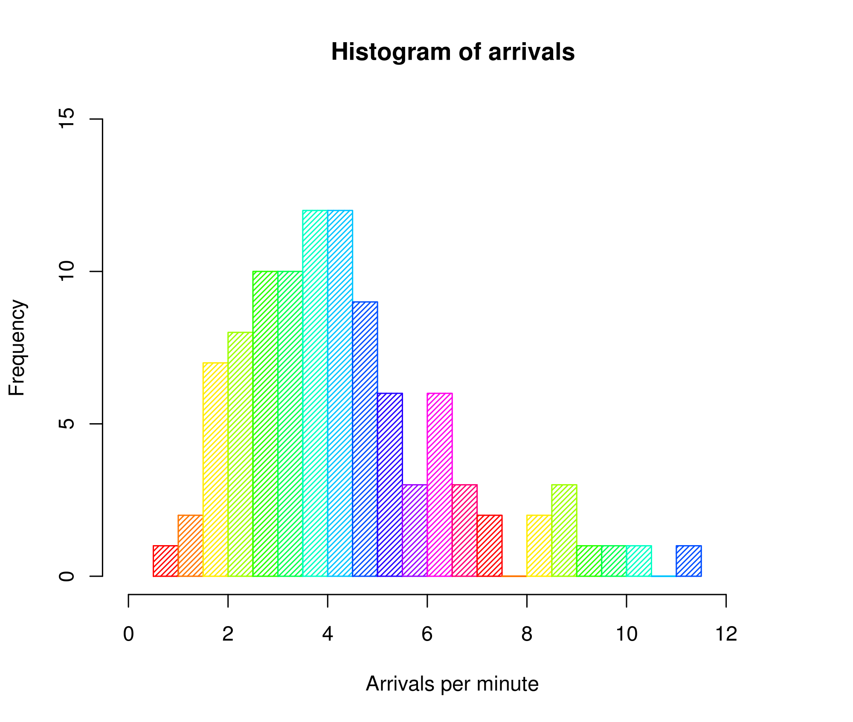
An example of a histogram

Slide 19
Variance measures how “spread-out” the data is.
Variance (𝜎²) is simply the average of the squared differences from the mean
Example: What is the variance of the data set (1, 4, 5, 4, 8)?
▫ First find the mean: (1+4+5+4+8)/5 = 4.4
▫ Now find the differences from the mean: (-3.4, -0.4, 0.6, -0.4, 3.6)
▫ Find the squared differences: (11.56, 0.16, 0.36, 0.16, 12.96)
▫ Find the average of the squared differences:
🞄 𝜎²= (11.56 + 0.16 + 0.36 + 0.16 + 12.96) / 5 = 5.04

Slide 20
Standard Deviation 𝜎 is just the square root of the
variance.
𝜎² = 5.04
2.5
2
1.5
𝜎 = 5.04 = 2.24
So the standard deviation of (1, 4, 5, 4, 8) is 2.24.
1
0.5
0
1 2 3 4 5 6 7
8
This is usually used as a way to identify outliers. Data points that lie more than one standard deviation from the mean can be considered unusual.
You can talk about how extreme a data point is by talking about “how many sigmas” away from the mean it is.

Slide 21
Population vs. Sample
If you’re working with a sample of data instead of an entire data set (the entire population)…
▫ Then you want to use the “sample variance” instead of the “population variance”
▫ For N samples, you just divide the squared variances by N-1 instead of N.
▫ So, in our example, we computed the population variance like this:
🞄 𝜎²= (11.56 + 0.16 + 0.36 + 0.16 + 12.96) / 5 = 5.04
▫ But the sample variance would be:
🞄 𝑆²= (11.56 + 0.16 + 0.36 + 0.16 + 12.96) / 4 = 6.3

Slide 22
Fancy Math
Population variance:
2
_{▫ 𝜎2 =} ∑ 𝑋𝑋−𝜇
𝑁
Sample variance:
2
_{▫ 𝑠2 =} ∑(𝑋𝑋−𝑀)
𝑁−1

Slide 23
Let’s look at another example.

Slide 24
Probability Density Functions

Slide 25

Example: a “normal distribution”

Slide 26
Gives you the probability of a data point falling within some given range of a given value.

Slide 27
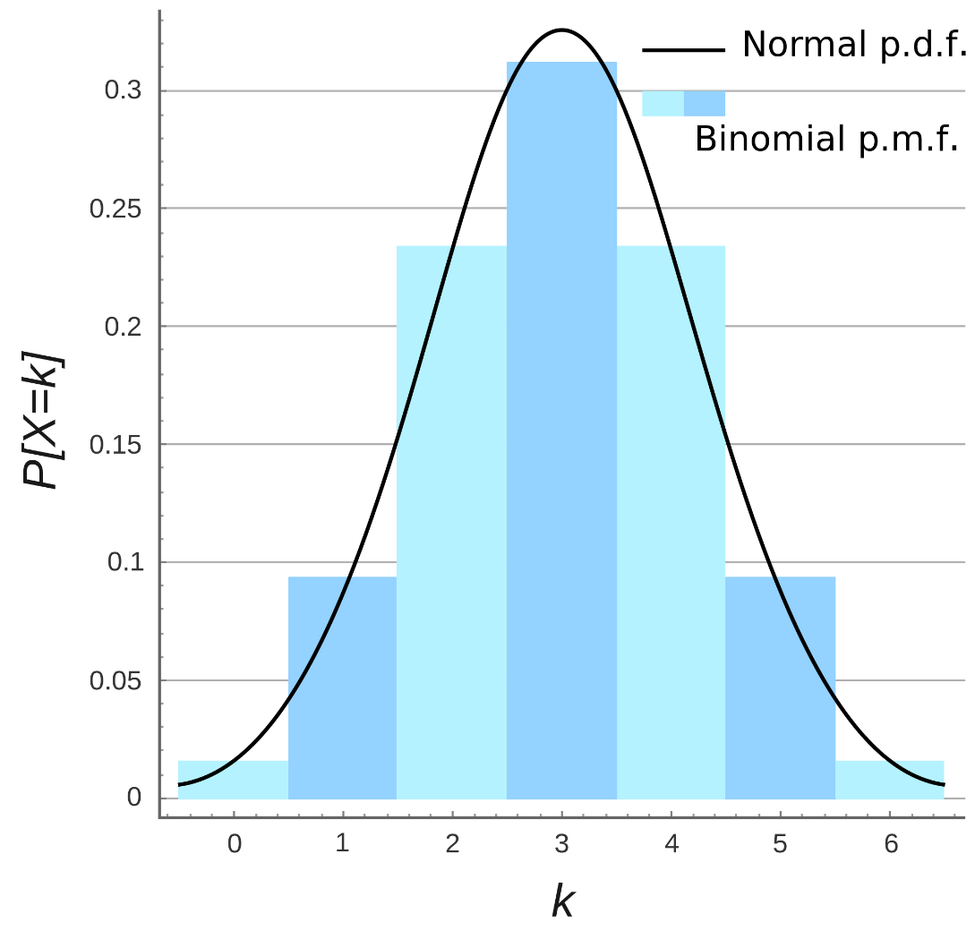
Probability Mass Function

Slide 28
Let’s play with some examples.

Slide 29
Percentiles and Moments

Slide 30
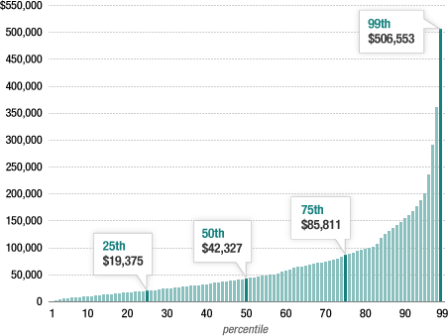
Percentiles
In a data set, what’s the point at which X% of the values are less than that value?
Example: income distribution

Slide 31
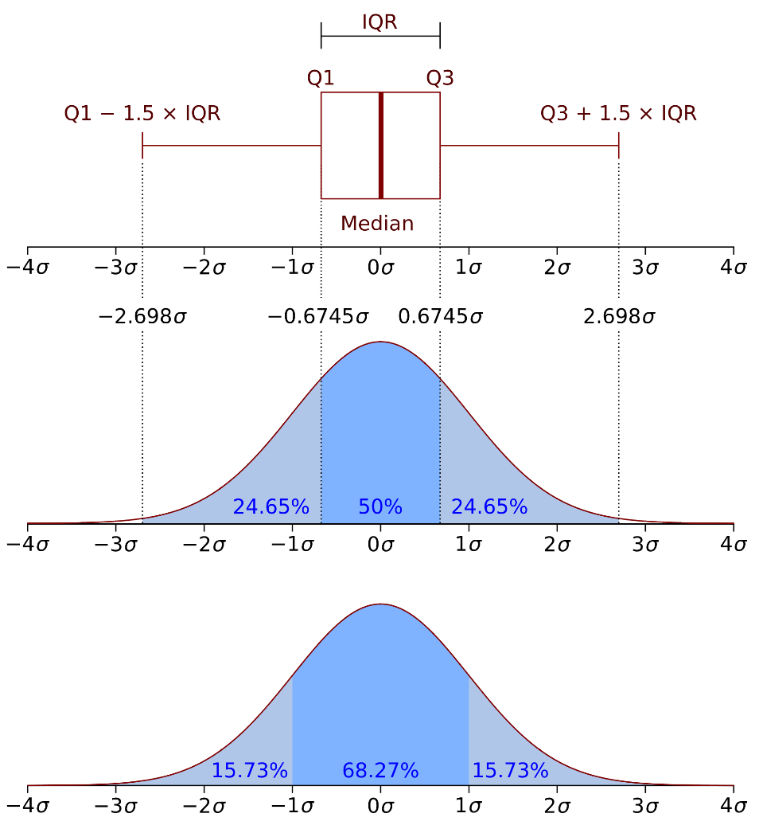
Percentiles in a normal distribution

Slide 32
Let’s look at some examples.

Slide 33
Moments
Quantitative measures of the shape of a probability density function
Mathematically they are a bit hard to wrap your head around:
∞
▫ 𝜇 = 𝑥 − 𝑐 ^{𝑛}𝑓𝑓 𝑥 𝑑𝑥 (for moment 𝑛 around value 𝑐)
𝑛
∫−∞
But intuitively, it’s a lot simpler in statistics.

Slide 34
The first moment is the mean.

Slide 35
The second moment is the variance.

Slide 36
Yes, it’s just that simple.

Slide 37
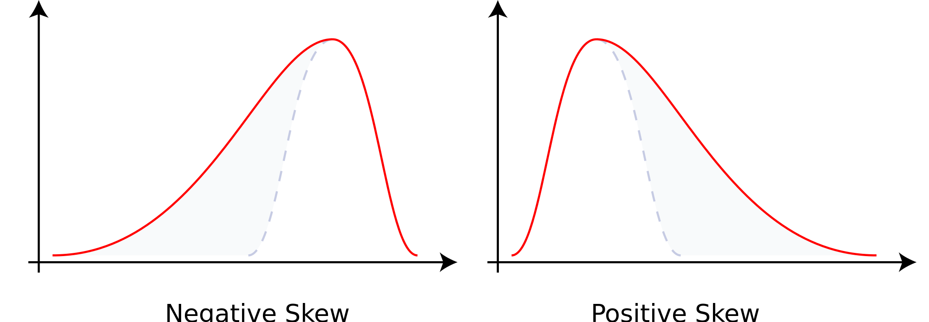
The third moment is “skew” (𝛾𝛾)
How “lopsided” is the distribution?
A distribution with a longer tail on the left will be skewed left, and have a negative skew.

Slide 38
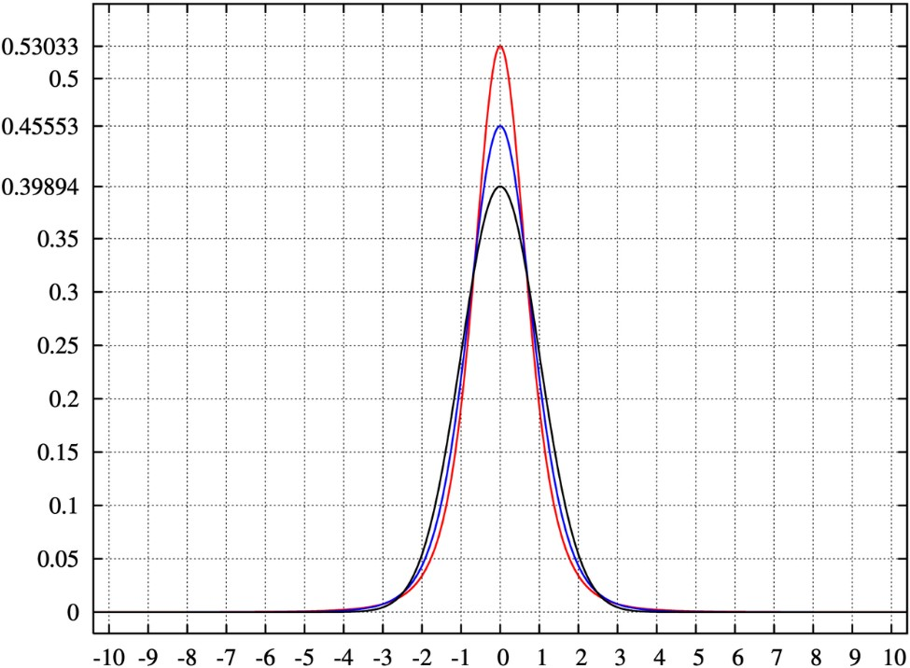
The fourth moment is “kurtosis”
How thick is the tail, and how sharp is the peak, compared to a normal distribution?
Example: higher peaks have higher kurtosis

Slide 39
Let’s compute the 4 moments in Python.

Slide 40
Covariance and Correlation

Slide 41
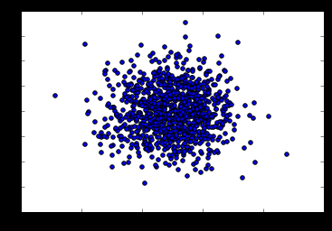
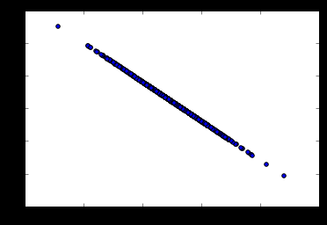
Covariance
Measures how two variables vary in tandem from their means.

Slide 42
Measuring covariance
Think of the data sets for the two variables as high-dimensional vectors
Convert these to vectors of variances from the mean
Take the dot product (cosine of the angle between them) of the two vectors
Divide by the sample size

Slide 43
Interpreting covariance is hard
We know a small covariance, close to 0, means there isn’t much correlation between the two variables.
And large covariances – that is, far from 0 (could be negative for inverse relationships) mean there is a correlation
But how large is “large”?

Slide 44
That’s where correlation comes in!
Just divide the covariance by the standard deviations of both variables, and that normalizes things.
So a correlation of -1 means a perfect inverse correlation
Correlation of 0: no correlation
Correlation 1: perfect correlation

Slide 45
Remember: correlation does not imply causation!
Only a controlled, randomized experiment can give you insights on causation.
Use correlation to decide what experiments to conduct!

Slide 46
Let’s play with some data.

Slide 47
Conditional Probability

Slide 48
Conditional Probability
If I have two events that depend on each other, what’s the probability that both will occur?
Notation: P(A,B) is the probability of A and B both occurring
P(B|A) : Probability of B given that A has occurred
We know:
P(B|A) = ^{P(A,B)}
P(A)

Slide 49
For example
I give my students two tests. 60% of my students passed both tests, but the first test was easier – 80% passed that one. What percentage of students who passed the first test also passed the second?
A = passing the first test, B = passing the second test
So we are asking for P(B|A) – the probability of B given A
P(B|A) = ^{P(A,B)} = ^{0.6} = 0.75
P(A) 0.8
75% of students who passed the first test passed the second.

Slide 50
Let’s do another example using Python.

Slide 51
Bayes’ Theorem

Slide 52
Bayes’ Theorem
Now that you understand conditional probability, you can understand Bayes’ Theorem:
𝑃 𝐴 𝑃 𝐵 𝐴
𝑃 𝐴 𝐵 =
𝑃 𝐵
In English – the probability of A given B, is the probability of A times the probability of B given A over the probability of B.
The key insight is that the probability of something that depends on B depends very much on the base probability of B and A. People ignore this all the time.

Slide 53
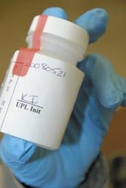
Bayes’ Theorem to the rescue
Drug testing is a common example. Even a “highly accurate” drug test can produce more false positives than true positives.
Let’s say we have a drug test that can accurately identify users of a drug 99% of the time, and accurately has a negative result for 99% of non- users. But only 0.3% of the overall population actually uses this drug.

Slide 54
Bayes’ Theorem to the rescue
Event A = Is a user of the drug, Event B = tested positively for the drug.
We can work out from that information that P(B) is 1.3% (0.99 * 0.003 +
0.01 * 0.997 – the probability of testing positive if you do use, plus the probability of testing positive if you don’t.)
𝑃 𝐴 𝑃 𝐵 𝐴 0.003 ∗0.99
= = = 22.8%
𝑃 𝐵 0.013
𝑃 𝐴 𝐵
So the odds of someone being an actual user of the drug given that they tested positive is only 22.8%!
Even though P(B|A) is high (99%), it doesn’t mean P(A|B) is high.

Slide 55
Linear Regression

Slide 56
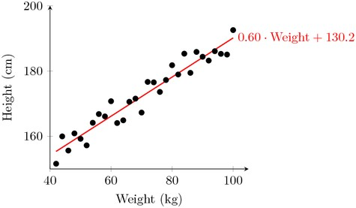
Linear Regression
Fit a line to a data set of observations
Use this line to predict unobserved values
I don’t know why they call it “regression.” It’s really misleading. You can use it to predict points in the future, the past, whatever. In fact time usually has nothing to do with it.

Slide 57
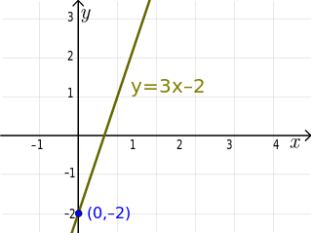
Linear Regression: How does it work?
Usually using “least squares”
Minimizes the squared-error between each point and the line
Remember the slope-intercept equation of a line? y=mx+b
The slope is the correlation between the two variables times the standard deviation in Y, all divided by the standard deviation in X.
▫ Neat how standard deviation how some real mathematical meaning, eh?
The intercept is the mean of Y minus the slope times the mean of X
But Python will do all that for you.

Slide 58
Linear Regression: How does it work?
Least squares minimizes the sum of squared errors.
This is the same as maximizing the likelihood of the observed data if you start thinking of the problem in terms of probabilities and probability distribution functions
This is sometimes called “maximum likelihood estimation”

Slide 59
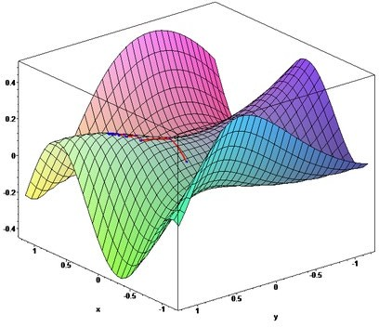
More than one way to do it
Gradient Descent is an alternate method to least squares.
Basically iterates to find the line that best follows the contours defined by the data.
Can make sense when dealing with 3D data
Easy to try in Python and just compare the results to least squares
▫ But usually least squares is a perfectly good choice.

Slide 60
Measuring error with r-squared
How do we measure how well our line fits our data?
R-squared (aka coefficient of determination) measures:
The fraction of the total variation in Y that is captured by the model

Slide 61
Computing r-squared
1.0 -
𝑠𝑢𝑚 𝑜𝑜𝑜 𝑠𝑞𝑢𝑎𝑟𝑒𝑑 𝑒𝑟𝑟𝑜𝑟𝑠
𝑠𝑢𝑚 𝑜𝑜𝑜 𝑠𝑞𝑢𝑎𝑟𝑒𝑑 𝑣𝑎𝑟𝑣𝑣𝑎𝑡𝑣𝑣𝑜𝑛 𝑜𝑜𝑟𝑜𝑚 𝑚𝑒𝑎𝑛

Slide 62
Interpreting r-squared
Ranges from 0 to 1
0 is bad (none of the variance is captured), 1 is good (all of the variance is captured).

Slide 63
Let’s play with an example.

Slide 64
Polynomial Regression

Slide 65
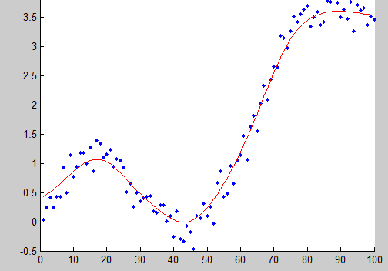
Why limit ourselves to straight lines?
Not all relationships are linear.
Linear formula: y = mx + b
▫ This is a “first order” or “first degree” polynomial, as the power of x is 1
Second order polynomial: 𝑦 = 𝑎𝑥² +
𝑏𝑥 + 𝑐
Third order: 𝑦 = 𝑎𝑥³ + 𝑏𝑥² + 𝑐𝑥 + 𝑑
Higher orders produce more complex curves.

Slide 66
Beware overfitting
Don’t use more degrees than you need
Visualize your data first to see how complex of a curve there might really be
Visualize the fit – is your curve going out of its way to accommodate outliers?
A high r-squared simply means your curve fits your training data well; but it may not be a good predictor.
Later we’ll talk about more principled ways to detect overfitting (train/test)

Slide 67
Let’s play with an example
numpy.polyfit() makes it easy.

Slide 68
Multiple Regression

Slide 69
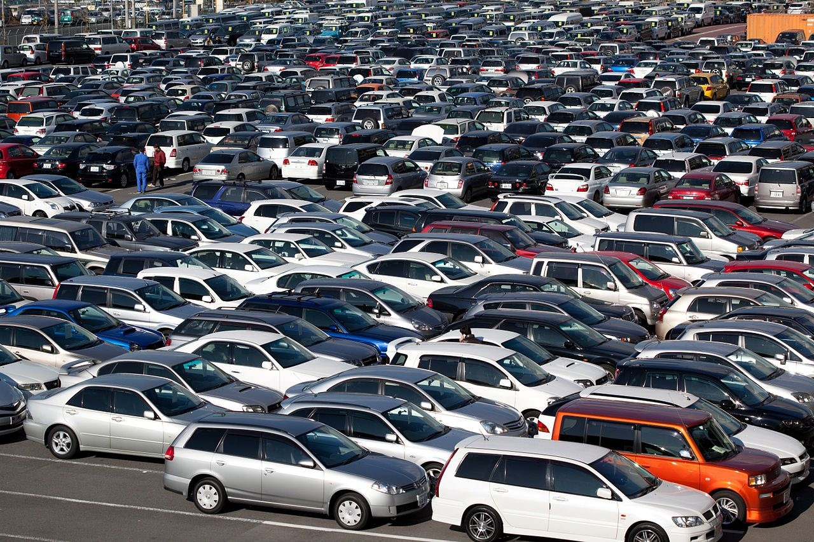
Multiple Regression
What if more than one variable influences the one you’re interested in?
Example: predicting a price for a car based on its many attributes (body style, brand, mileage, etc.)
If you also have multiple dependent variables – things you’re trying to predict – that’s “multivariate regression”

Slide 70
Still uses least squares
We just end up with coefficients for each factor.
▫ For example, 𝑝𝑟𝑝𝑝𝑐𝑒 = 𝛼 + 𝛽₁mileage + 𝛽₂age + 𝛽₃doors
▫ These coefficients imply how important each factor is (if the data is all normalized!)
▫ Get rid of ones that don’t matter!
Can still measure fit with r-squared
Need to assume the different factors are not themselves dependent on each other.

Slide 71
Let’s dive into an example.
The statsmodel package makes it easy.

Slide 72
Multi-Level Models

Slide 73
Multi-Level Models
The concept is that some effects happen at various levels.
Example: your health depends on a hierarchy of the health of your cells, organs, you as a whole, your family, your city, and the world you live in.
Your wealth depends on your own work, what your parents did, what your grandparents did, etc.
Multi-level models attempt to model and account for these interdependencies.

Slide 74
Modeling multiple levels
You must identify the factors that affect the outcome you’re trying to predict at each level.
For example – SAT scores might be predicted based on the genetics of individual children, the home environment of individual children, the crime rate of the neighborhood they live in, the quality of the teachers in their school, the funding of their school district, and the education policies of their state.
Some of these factors affect more than one level. For example, crime rate might influence the home environment too.

Slide 75

Doing this is hard.
I just want you to be aware of the concept, as multi-level models showed up on some data science job requirements I’ve seen.
You’re not ready for it yet. Entire advanced statistics and modeling courses exist on this one topic alone.
Thick books exist on it too, when you’re ready.

Slide 76
Supervised and Unsupervised Machine Learning
And the concept of train/test

Slide 77

What is machine learning?
Algorithms that can learn from observational data, and can make predictions based on it.
Yeah, that’s pretty much what your own brain does too.

Slide 78

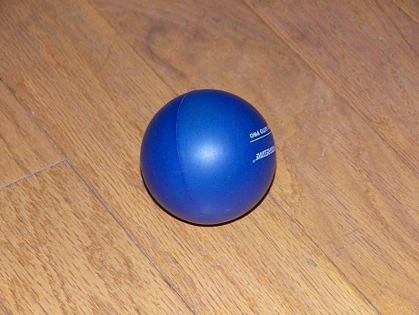
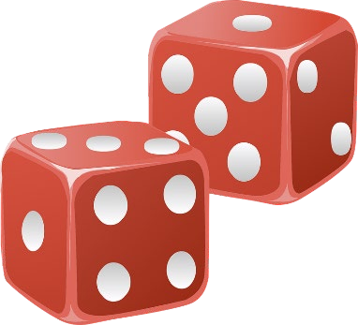
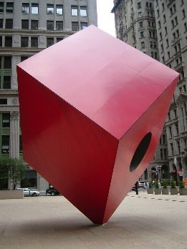
Unsupervised Learning
The model is not given any “answers” to learn from; it must make sense of the data just given the observations themselves.
Example: group (cluster) some objects together into 2 different sets. But I don’t tell you what the “right” set is for any object ahead of time.
Do I want big and small things? Round and square things? Red and blue things? Unsupervised learning could give me any of those results.

Slide 79
Unsupervised Learning
Unsupervised learning sounds awful! Why use it?
Maybe you don’t know what you’re looking for – you’re looking for
latent variables.
Example: clustering users on a dating site based on their information and behavior. Perhaps you’ll find there are groups of people that emerge that don’t conform to your known stereotypes.
Cluster movies based on their properties. Perhaps our current concepts of genre are outdated?
Analyze the text of product descriptions to find the terms that carry the most meaning for a certain category.

Slide 80
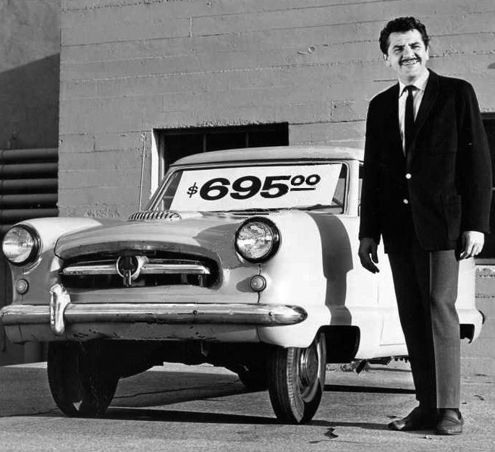
Supervised Learning
In supervised learning, the data the algorithm “learns” from comes with the “correct” answers.
The model created is then used to predict the answer for new, unknown values.
Example: You can train a model for predicting car prices based on car attributes using historical sales data. That model can then predict the optimal price for new cars that haven’t been sold before.

Slide 81

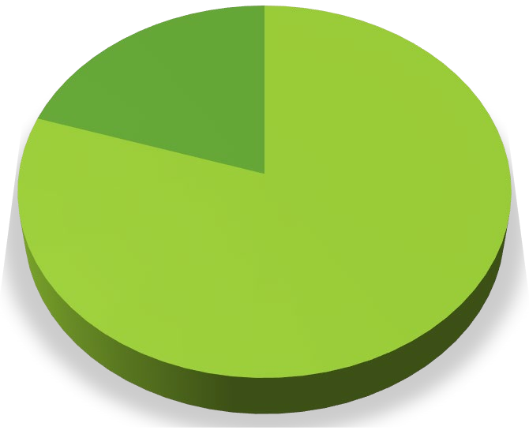




Evaluating Supervised Learning
If you have a set of training data that includes the value you’re trying to predict – you don’t have to guess if the resulting model is good or not.
If you have enough training data, you can split it into two parts: a training set and a test set.
You then train the model using only the training set
And then measure (using r-squared or some other metric) the model’s accuracy by asking it to predict values for the test set, and compare that to the known, true values.
Car Sales Data
Test set 20%
Training set 80%
Training set
Test set

Slide 82
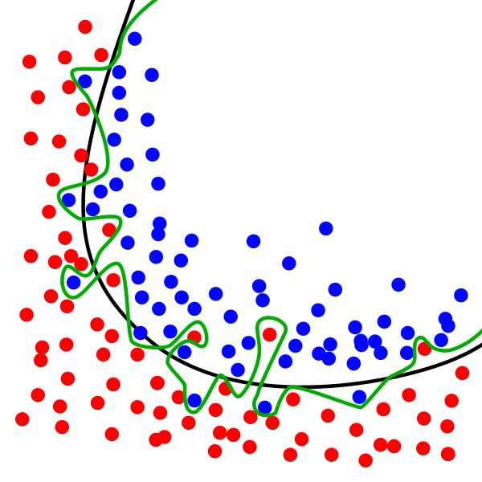
Train / Test in practice
Need to ensure both sets are large enough to contain representatives of all the variations and outliers in the data you care about
The data sets must be selected randomly
Train/test is a great way to guard against overfitting

Slide 83
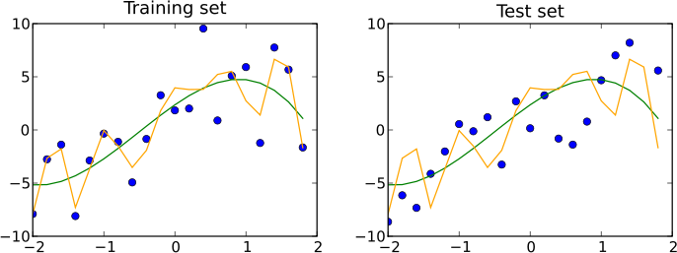
Train/Test is not Infallible
Maybe your sample sizes are too small
Or due to random chance your train and test sets look remarkably similar
Overfitting can still happen

Slide 84
K-fold Cross Validation
One way to further protect against overfitting is K-fold cross validation
Sounds complicated. But it’s a simple idea:
▫ Split your data into K randomly-assigned segments
▫ Reserve one segment as your test data
▫ Train on each of the remaining K-1 segments and measure their performance against the test set
▫ Take the average of the K-1 r-squared scores

Slide 85
Let’s go do some training and testing.

Slide 86
Bayesian Methods

Slide 87
Remember Bayes’ Theorem?
₌ 𝑃 𝐴 𝑃(𝐵|𝐴)
𝑃 𝐴 𝐵
𝑃 𝐵
Let’s use it for machine learning! I want a spam classifier.
Example: how would we express the probability of an email being spam if it contains the word “free”?
_{𝐹𝑟𝑒𝑒) =} 𝑃 𝑆𝑝𝑎𝑚 𝑃 𝐹𝑟𝑒𝑒
𝑆𝑝𝑎𝑚)
𝑃 𝑆𝑝𝑎𝑚
𝑃 𝐹𝑟𝑒𝑒
The numerator is the probability of a message being spam and containing the word “free” (this is subtly different from what we’re looking for)
The denominator is the overall probability of an email containing the word “free”. (Equivalent to P(Free|Spam)P(Spam) + P(Free|Not Spam)P(Not Spam))
So together – this ratio is the % of emails with the word “free” that are spam.

Slide 88

What about all the other words?
We can construct P(Spam | Word) for every (meaningful) word we encounter during training
Then multiply these together when analyzing a new email to get the probability of it being spam.
Assumes the presence of different words are independent of each other – one reason this is called “Naïve Bayes”.

Slide 89
Sounds like a lot of work.
Scikit-learn to the rescue!
The CountVectorizer lets us operate on lots of words at once, and MultinomialNB does all the heavy lifting on Naïve Bayes.
We’ll train it on known sets of spam and “ham” (non-spam) emails
▫ So this is supervised learning!
Let’s do this

Slide 90
K-Means Clustering

Slide 91
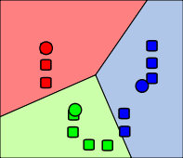
K-Means Clustering
Attempts to split data into K groups that are closest to K centroids
Unsupervised learning – uses only the positions of each data point
Can uncover interesting groupings of people
/ things / behavior
▫ Example: Where do millionaires live?
▫ What genres of music / movies / etc. naturally fall out of data?
▫ Create your own stereotypes from demographic data

Slide 92
K-Means Clustering
Sounds fancy! Wow! Unsupervised machine learning! Clusters! K!
Actually how it works is really simple.
▫ Randomly pick K centroids (k-means)
▫ Assign each data point to the centroid it’s closest to
▫ Recompute the centroids based on the average position of each centroid’s points
▫ Iterate until points stop changing assignment to centroids
If you want to predict the cluster for new points, just find the centroid they’re closest to.

Slide 93
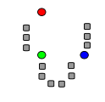
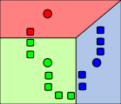
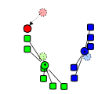
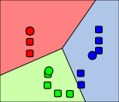
Graphical example
Images from Wikimedia Commons

Slide 94
K-Means Clustering Gotchas
Choosing K
▫ Try increasing K values until you stop getting large reductions in squared error (distances from each point to their centroids)
Avoiding local minima
▫ The random choice of initial centroids can yield different results
▫ Run it a few times just to make sure your initial results aren’t wacky
Labeling the clusters
▫ K-Means does not attempt to assign any meaning to the clusters you find
▫ It’s up to you to dig into the data and try to determine that

Slide 95
Let’s cluster stuff.
Again, scikit-learn makes this easy.

Slide 96
Entropy

Slide 97
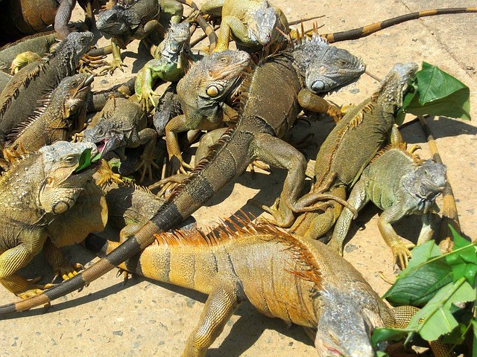
Entropy
A measure of a data set’s disorder – how same or different it is.
If we classify a data set into N different classes (example: a data set of animal attributes and their species)
▫ The entropy is 0 if all of the classes in the data are the same (everyone is an iguana)
▫ The entropy is high if they’re all different
Again, a fancy word for a simple concept.

Slide 98
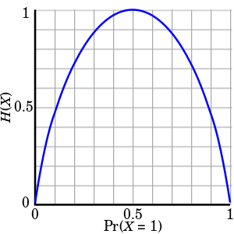
Computing entropy
𝐻 𝑆 = −𝑝₁ ln 𝑝₁ − ⋯ − 𝑝_{𝑛} ln 𝑝_{𝑛}
𝑝_{𝑣𝑣} represents the proportion of the data labeled for each class
Each term looks like this:

Slide 99
Decision Trees

Slide 100
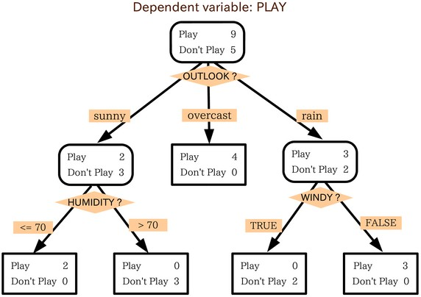
Decision Trees
You can actually construct a flowchart to help you decide a classification for something with machine learning
This is called a Decision Tree
Another form of supervised learning
▫ Give it some sample data and the resulting classifications
▫ Out comes a tree!

Slide 101
Decision Tree example
You want to build a system to filter out resumes based on historical hiring data
You have a database of some important attributes of job candidates, and you know which ones were hired and which ones weren’t
You can train a decision tree on this data, and arrive at a system for predicting whether a candidate will get hired based on it!

Slide 102
Totally Fabricated Hiring Data
Candidate ID | Years Experience | Employed? | Previous employers | Level of Education | Top-tier school | Interned | Hired
0 | 10 | 1 | 4 | 0 | 0 | 0 | 1
1 | 0 | 0 | 0 | 0 | 1 | 1 | 1
2 | 7 | 0 | 6 | 0 | 0 | 0 | 0
3 | 2 | 1 | 1 | 1 | 1 | 0 | 1
4 | 20 | 0 | 2 | 2 | 1 | 0 | 0

Slide 103
Totally Fabricated Should-I-Hire-This-Person Tree
Did an internship?
No Yes
Currently employed?
Hire!
No Yes
Less than one prior employer?
Hire!
No Yes
Attended a top-tier school?
Don’t Hire!
Don’t Hire!
No Yes
Hire!

Slide 104
How Decision Trees Work
At each step, find the attribute we can use to partition the data set to minimize the entropy of the data at the next step
Fancy term for this simple algorithm: ID3
It is a greedy algorithm – as it goes down the tree, it just picks the decision that reduce entropy the most at that stage.
▫ That might not actually result in an optimal tree.
▫ But it works.

Slide 105

Random Forests
Decision trees are very susceptible to overfitting
To fight this, we can construct several alternate decision trees and let them “vote” on the final classification
▫ Randomly re-sample the input data for each tree (fancy term for this: bootstrap aggregating or bagging)
▫ Randomize a subset of the attributes each step is allowed to choose from

Slide 106
Let’s go make some trees.
Yet again, scikit-learn is awesome for this.

Slide 107
Ensemble Learning

Slide 108

Ensemble Learning
Random Forests was an example of ensemble learning
It just means we use multiple models to try and solve the same problem, and let them vote on the results.

Slide 109
Ensemble Learning
Random Forests uses bagging (bootstrap aggregating) to implement ensemble learning
▫ Many models are built by training on randomly-drawn subsets of the data
Boosting is an alternate technique where each subsequent model in the ensemble boosts attributes that address data mis-classified by the previous model
A bucket of models trains several different models using training data, and picks the one that works best with the test data
Stacking runs multiple models at once on the data, and combines the results together
▫ This is how the Netflix prize was won!

Slide 110
Advanced Ensemble Learning: Ways to Sound Smart
Bayes Optimal Classifier
▫ Theoretically the best – but almost always impractical
Bayesian Parameter Averaging
▫ Attempts to make BOC practical – but it’s still misunderstood, susceptible to overfitting, and often outperformed by the simpler bagging approach
Bayesian Model Combination
▫ Tries to address all of those problems
▫ But in the end, it’s about the same as using cross-validation to find the best combination of models

Slide 111
XGBoost

Slide 112
XGBoost
booster[0]:
0:[f2<2.3499999] yes=1,no=2,missing=1
1:leaf=0.425454557
2:leaf=-0.218918934
booster[1]:
0:[f2<2.3499999] yes=1,no=2,missing=1
1:leaf=-0.212727293
2:[f3<1.75] yes=3,no=4,missing=3
3:[f2<4.94999981] yes=5,no=6,missing=5
5:leaf=0.404698014
6:leaf=0.0310344752
4:[f2<4.94999981] yes=7,no=8,missing=7
7:leaf=-0.0360000096
8:leaf=-0.212101951
booster[2]:
0:[f3<1.6500001] yes=1,no=2,missing=1
1:[f2<4.94999981] yes=3,no=4,missing=3
3:leaf=-0.218272462
4:leaf=0.179999992
2:[f2<4.85000038] yes=5,no=6,missing=5
5:leaf=0.128571421
6:leaf=0.410059184
booster[3]:
0:[f2<2.3499999] yes=1,no=2,missing=1
1:leaf=0.293001503
2:leaf=-0.195878834
booster[4]:
0:[f2<2.3499999] yes=1,no=2,missing=1
1:leaf=-0.189249262
2:[f3<1.75] yes=3,no=4,missing=3
3:[f2<4.94999981] yes=5,no=6,missing=5
5:leaf=0.278669834
6:leaf=0.0307718068
4:[f2<4.94999981] yes=7,no=8,missing=7
7:leaf=-0.0279411841
8:leaf=-0.189206496
eXtreme Gradient Boosted trees
Remember boosting is an ensemble method
▫ Each tree boosts attributes that led to mis- classifications of previous tree
It is AMAZING
▫ Routinely wins Kaggle competitions
▫ Easy to use
▫ Fast
▫ A good choice for an algorithm to start with

Slide 113
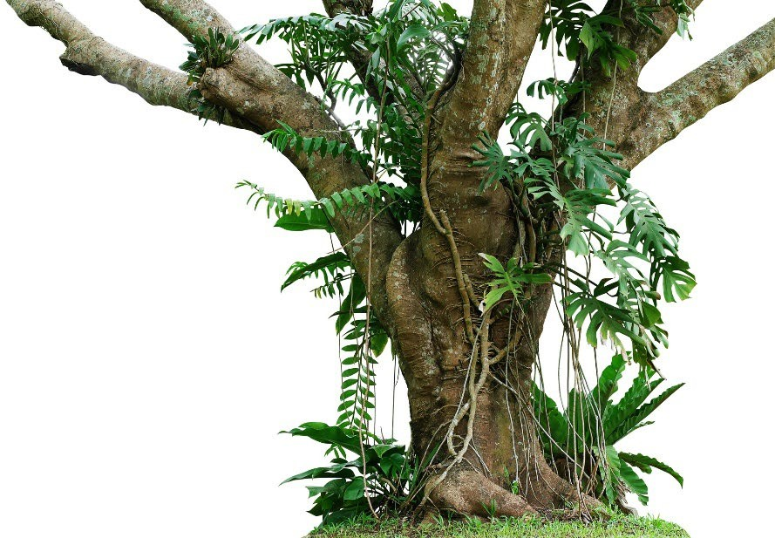
Features of XGBoost
Regularized boosting (prevents overfitting)
Can handle missing values automatically
Parallel processing
Can cross-validate at each iteration
▫ Enables early stopping, finding optimal number of iterations
Incremental training
Can plug in your own optimization objectives
Tree pruning
▫ Generally results in deeper, but optimized, trees

Slide 114
Using XGBoost
Pip install xgboost
Also CLI, C++, R, Julia, JVM interfaces
It’s not just made for scikit_learn, so it has its own interface
▫ Uses DMatrix structure to hold features & labels
🞄 Can create this easily from a numpy array though
▫ All parameters passed in via a dictionary
Call train, then predict. It’s easy.

Slide 115

XGBoost Hyperparameters
Booster
▫ gbtree or gblinear
Objective (ie, multi:softmax, multi:softprob)
Eta (learning rate – adjusts weights on each step)
Max_depth (depth of the tree)
Min_child_weight
▫ Can control overfitting, but too high will underfit
…and many others

Slide 116

XGBoost
It’s almost all that you need to know for ML in practical terms, at least for simple classification or regression problems.
Let’s see it in action.

Slide 117
Support Vector Machines

Slide 118
Support Vector Machines
Works well for classifying higher-dimensional data (lots of features)
Finds higher-dimensional support vectors across which to divide the data (mathematically, these support vectors define hyperplanes. Needless to say I’m not going to get into the mathematical details!)
Uses something called the kernel trick to represent data in higher- dimensional spaces to find hyperplanes that might not be apparent in lower dimensions

Slide 119
Higher dimensions? Hyperplanes? Huh?
The important point is that SVM’s employ some advanced mathematical trickery to cluster data, and it can handle data sets with lots of features.
It’s also fairly expensive – the “kernel trick” is the only thing that makes it possible.

Slide 120
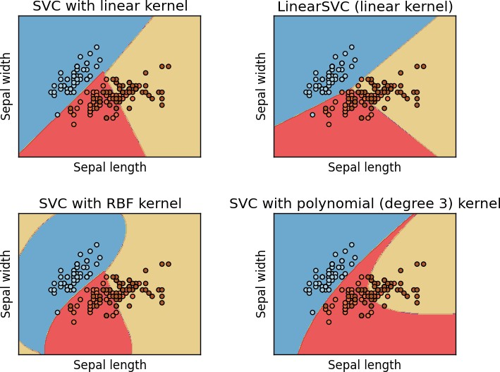
Support Vector Classification
In practice you’ll use something called SVC to classify data using SVM.
You can use different “kernels” with SVC. Some will work better than others for a given data set.

Slide 121
Let’s play with SVC’s
Don’t even try to do this without scikit-learn.

Slide 122
Recommender Systems

Slide 123

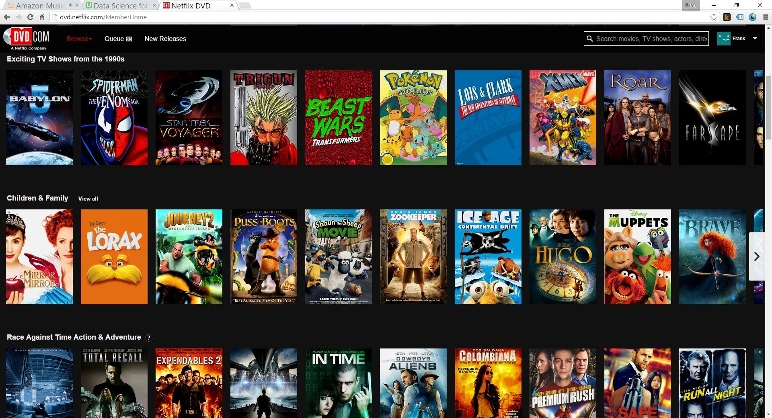
What are recommender systems?

Slide 124
User-Based Collaborative Filtering
Build a matrix of things each user bought/viewed/rated
Compute similarity scores between users
Find users similar to you
Recommend stuff they bought/viewed/rated that you haven’t yet.

Slide 125






User-Based Collaborative Filtering

Slide 126
User-Based Collaborative Filtering

Slide 127
Problems with User-Based CF
People are fickle; tastes change
There are usually many more people than things
People do bad things

Slide 128
What if we based recommendations on relationships between things instead of people?
A movie will always be the same movie – it doesn’t change
There are usually fewer things than people (less computation to do)
Harder to game the system

Slide 129
Item-Based Collaborative Filtering
Find every pair of movies that were watched by the same person
Measure the similarity of their ratings across all users who watched both
Sort by movie, then by similarity strength
(This is just one way to do it!)

Slide 130

Item-Based Collaborative Filtering

Slide 131
Item-Based Collaborative Filtering

Slide 132
Item-Based Collaborative Filtering

Slide 133
Item-Based Collaborative Filtering

Slide 134
Let’s Do This
Next, we’ll use Python to create real “movie similarities” using the real MovieLens data set.
▫ In addition to being important for item-based collaborative filtering, these results are valuable in themselves – think “people who liked X also liked Y”
It’s real world data, and we’ll encounter real world problems
Then we’ll use those results to create movie recommendations for individuals

Slide 135
K-Nearest Neighbor

Slide 136
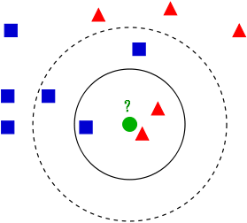
K-Nearest Neighbor (KNN)
Used to classify new data points based on “distance” to known data
Find the K nearest neighbors, based on your distance metric
Let them all vote on the classification
That’s it!

Slide 137
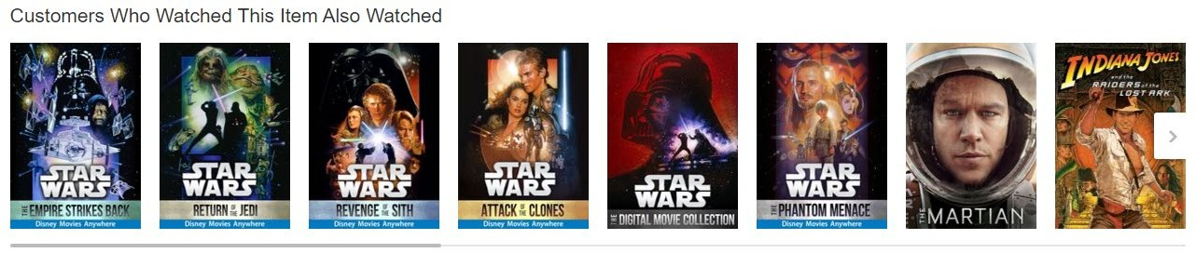
It’s Really That Simple
Although it’s one of the simplest machine learning models there is – it still qualifies as “supervised learning”.
But let’s do something more complex with it
Movie similarities just based on metadata!

Slide 138
Discrete Choice Models

Slide 139
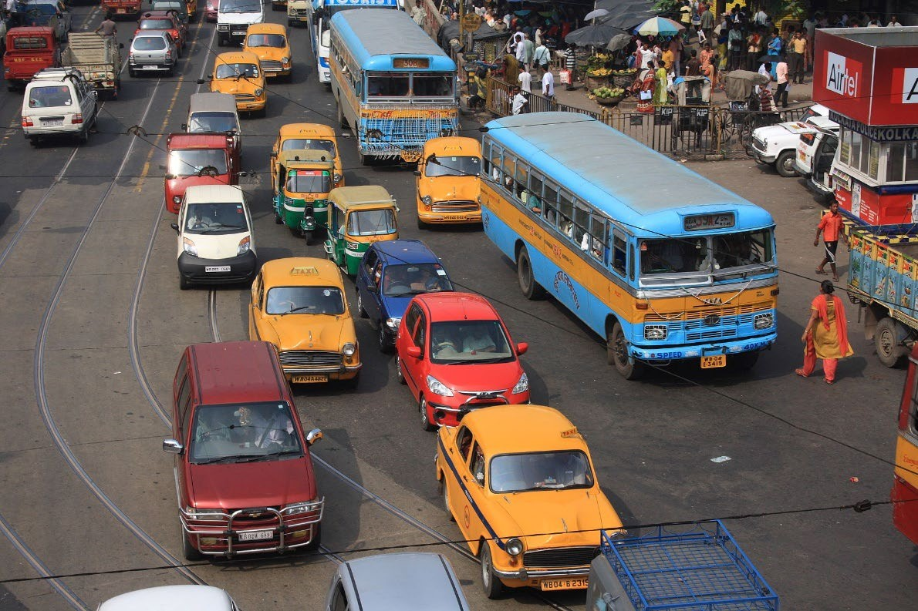
Discrete Choice Models
Predict some choice people have between discrete alternatives
▫ Do I take the train, bus, or car to work today? (Multinomial choice)
▫ Which college will I go to? (Multinomial)
▫ Will I cheat on my spouse? (Binary)
The alternatives must be finite, exhaustive, and mutually exclusive

Slide 140
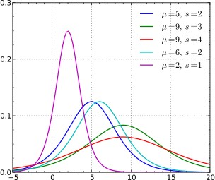
Discrete Choice Models
Use some sort of regression on the relevant attributes
▫ Attributes of the people
▫ Variables of the alternatives
Generally uses Logit or Probit models
▫ Logistic Regression, Probit Model
▫ Based on some utility function you define
▫ Similar – one uses logistic distribution, Probit uses normal distribution. Logistic looks a lot like normal, but with fatter tails (higher kurtosis)

Slide 141
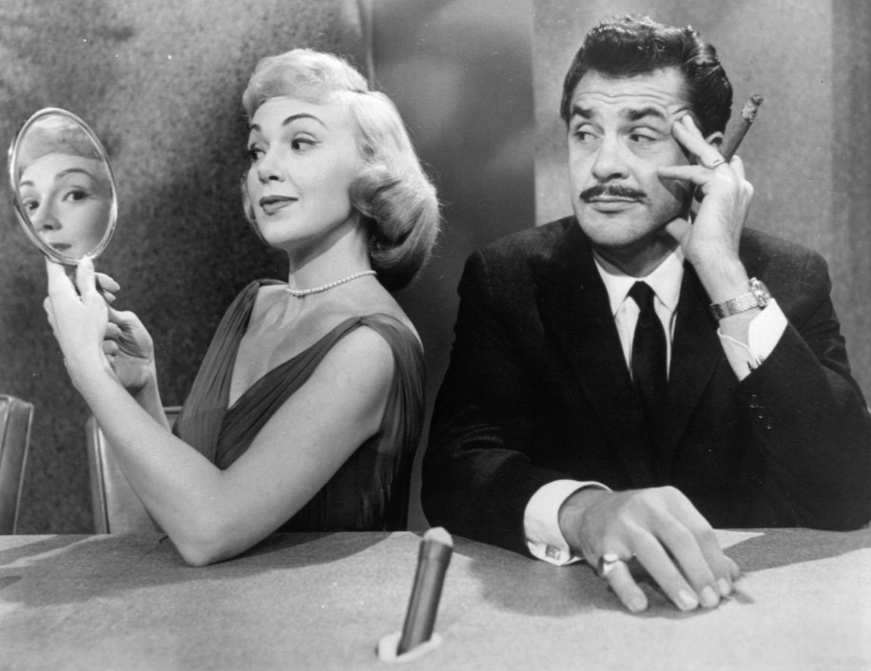
Example
Will my spouse cheat on me?

Slide 142
The Curse of Dimensionality
Principal Component Analysis

Slide 143
What is the curse of dimensionality?
Many problems can be thought of as having a huge number of “dimesions”
For example, in recommending movies, the ratings vector for each movie may represent a dimension – every movie is its own dimension!
That makes your head hurt. It’s tough to visualize.
Dimensionality reduction attempts to distill higher-dimensional data down to a smaller number of dimensions, while preserving as much of the variance in the data as possible.

Slide 144
Remember K-Means Clustering?
This is an example of a dimensionality reduction algorithm.
It reduces data down to K dimensions.

Slide 145
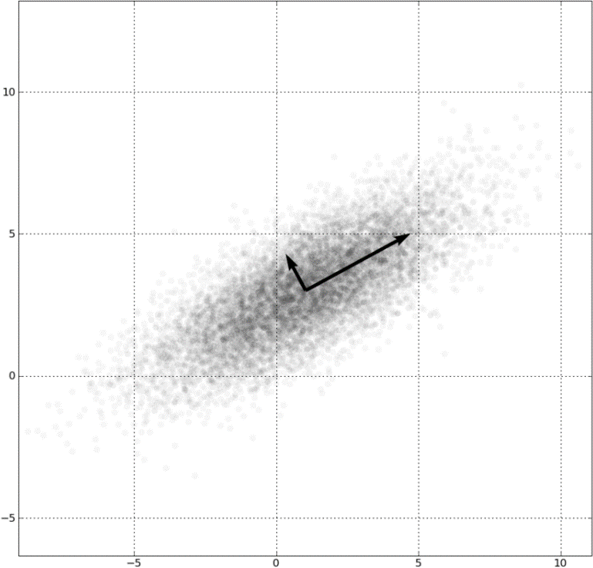
Another way: Principal Component Analysis (PCA)
Involves fancy math – but at a high level:
Finds “eigenvectors” in the higher dimensional data
▫ These define hyperplanes that split the data while preserving the most variance in it
▫ The data gets projected onto these hyperplanes, which represent the lower dimensions you want to represent
▫ A popular implementation of this is called Singular Value Decomposition (SVD)
Also really useful for things like image compression and facial recognition

Slide 146

Example: Visualizing 4-D Iris Flower Data
The “Iris dataset” comes with scikit-learn
An Iris flower has petals and sepals (the lower, supportive part of the flower.)
We know the length and width of the petals and sepals for many Iris specimens
▫ That’s four dimensions! Ow.
▫ We also know the subspecies classification of each flower
PCA lets us visualize this in 2 dimensions instead of 4, while still preserving variance.

Slide 147
Example: Visualizing 4-D Iris Flower Data
Yet again, scikit-learn makes this complex technique really easy.

Slide 148
ETL and ELT
Data Warehousing Introduction

Slide 149
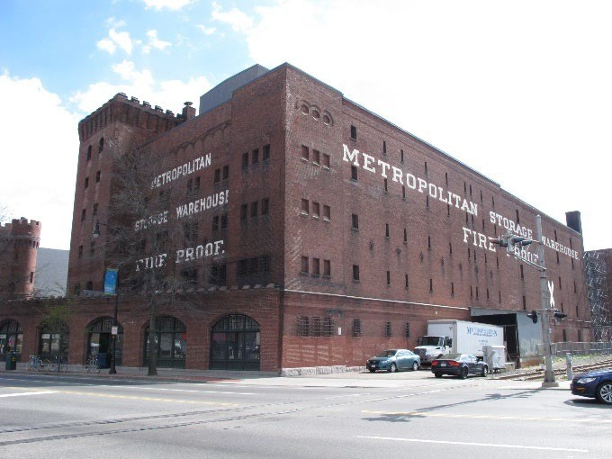
What is Data Warehousing?
A large, centralized database that contains information from many sources
Often used for business analysis in large corporations or organizations
Queried via SQL or tools (i.e. Tableau)
Often entire departments are dedicated to maintaining a data warehouse
▫ Data normalization is tricky – how does all of this data relate to each other? What views do people need?
▫ Maintaining the data feeds is a lot of work
▫ Scaling is tricky

Slide 150

ETL: Extract, Transform, Load
ETL and ELT refer to how data gets into a data warehouse.
Traditionally, the flow was Extract, Transform, Load:
▫ Raw data from operational systems is first periodically
extracted
▫ Then, the data is transformed into the schema needed by the DW
▫ Finally, the data is loaded into the data warehouse, already in the structure needed
But what if we’re dealing with “big data”? That transform step can turn into a big problem.

Slide 151

ELT: Extract, Load, Transform
Today, a huge Oracle instance isn’t the only choice for a large data warehouse
Things like Hive let you host massive databases on a Hadoop cluster
Or, you might store it in a large, distributed NoSQL data store
▫ …and query it using things like Spark or MapReduce
The scalability of Hadoop lets you flip the loading process on its head
▫ Extract raw data as before
▫ Load it in as-is
▫ Then use the power of Hadoop to transform it in-place

Slide 152

Lots more to explore
Data warehousing is a discipline in itself, too big too cover here
Check out other courses on Big Data, Spark, and MapReduce
▫ We will cover Spark in more depth later in this course.

Slide 153
Reinforcement Learning

Slide 154
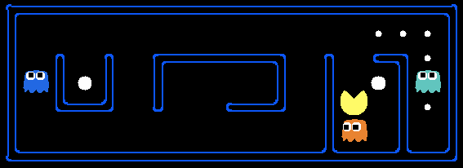
Reinforcement Learning
You have some sort of agent that “explores” some space
As it goes, it learns the value of different state changes in different conditions
Those values inform subsequent behavior of the agent
Examples: Pac-Man, Cat & Mouse game
Yields fast on-line performance once the space has been explored

Slide 155
Q-Learning
A specific implementation of reinforcement learning
You have:
▫ A set of environmental states s
▫ A set of possible actions in those states a
▫ A value of each state/action Q
Start off with Q values of 0
Explore the space
As bad things happen after a given state/action, reduce its Q
As rewards happen after a given state/action, increase its Q

Slide 156
Q-Learning
Q(s, a) += alpha * (reward(s,a) + max(Q(s') - Q(s,a)) where s is the previous state, a is the previous action,s' is the current state, and alpha is the discount factor (set to .5 here).
What are some state/actions here?
▫ Pac-man has a wall to the West
▫ Pac-man dies if he moves one step South
▫ Pac-man just continues to live if going North or East
You can “look ahead” more than one step by using a discount factor when computing Q (here s is previous state, s’ is current state)
▫ Q(s,a) += discount * (reward(s,a) + max(Q(s’)) – Q(s,a))

Slide 157
The exploration problem
How do we efficiently explore all of the possible states?
▫ Simple approach: always choose the action for a given state with the highest Q. If there’s a tie, choose at random
🞄 But that’s really inefficient, and you might miss a lot of paths that way
▫ Better way: introduce an epsilon term
🞄 If a random number is less than epsilon, don’t follow the highest Q, but choose at random
🞄 That way, exploration never totally stops
🞄 Choosing epsilon can be tricky

Slide 158
Fancy Words
Markov Decision Process
▫ From Wikipedia: Markov decision processes (MDPs) provide a mathematical framework for modeling decision making in situations where outcomes are partly random and partly under the control of a decision maker.
▫ Sound familiar? MDP’s are just a way to describe what we just did using mathematical notation.
▫ States are still described as s and s’
▫ State transition functions are described as 𝑃_{𝑎} 𝑠, 𝑠𝑠
▫ Our “Q” values are described as a reward function 𝑅_{𝑎} 𝑠, 𝑠𝑠
Even fancier words! An MDP is a discrete time stochastic control process.

Slide 159
More Fancy Words
Dynamic Programming
▫ From Wikipedia: dynamic programming is a method for solving a complex problem by breaking it down into a collection of simpler subproblems, solving each of those subproblems just once, and storing their solutions - ideally, using a memory-based data structure. The next time the same subproblem occurs, instead of recomputing its solution, one simply looks up the previously computed solution, thereby saving computation time at the expense of a (hopefully) modest expenditure in storage space.
▫ Sound familiar?

Slide 160

So to recap
You can make an intelligent Pac-Man in a few steps:
▫ Have it semi-randomly explore different choices of movement (actions) given different conditions (states)
▫ Keep track of the reward or penalty associated with each choice for a given state/action (Q)
▫ Use those stored Q values to inform its future choices
Pretty simple concept. But hey, now you can say you understand reinforcement learning, Q-learning, Markov Decision Processes, and Dynamic Programming!

Slide 161
Implementing Reinforcement Learning
Python Markov Decision Process Toolbox:
▫ http://pymdptoolbox.readthedocs.org/en/latest/api/mdp.html
Cat & Mouse Example:
▫ https://github.com/studywolf/blog/tree/master/RL/Cat%20vs%20Mouse% 20exploration
Pac-Man Example:
▫ https://inst.eecs.berkeley.edu/~cs188/sp12/projects/reinforcement/reinfor cement.html

Slide 162
Confusion Matrix

Slide 163

Sometimes accuracy doesn’t tell the whole story
A test for a rare disease can be 99.9% accurate by just guessing “no” all the time
We need to understand true positives and true negative, as well as false positives and false negatives.
A confusion matrix shows this.

Slide 164
Binary confusion matrix
 | Actual YES | Actual NO
Predicted YES | TRUE POSITIVES | FALSE POSITIVES
Predicted NO | FALSE NEGATIVES | TRUE NEGATIVE

Slide 165

Image has cat?
 | Actual cat | Actual not cat
Predicted cat | 50 | 5
Predicted not cat | 10 | 100

Slide 166
Another format
 | Predicted NO | Predicted YES
Actual NO | 50 | 5 | 55
Actual YES | 10 | 100 | 110
 | 60 | 105

Slide 167
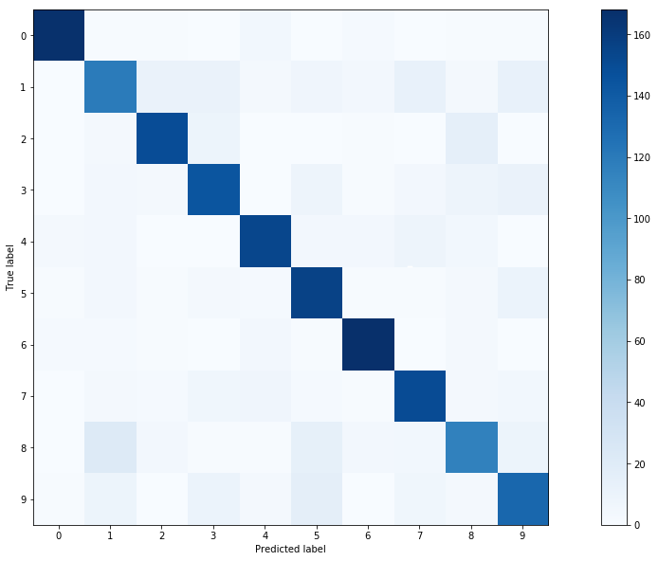
Multi-class confusion matrix + heat map

Slide 168
Measuring your Models

Slide 169
Remember our friend the confusion matrix
 | Actual YES | Actual NO
Predicted YES | TRUE POSITIVES | FALSE POSITIVES
Predicted NO | FALSE NEGATIVES | TRUE NEGATIVE

Slide 170
Recall
𝑇𝑅𝑈𝐸 𝑃𝑃𝑃𝑆𝐼𝑇𝐼𝑉𝐸𝑆
•
𝑇𝑅𝑈𝐸 𝑃𝑃𝑃𝑆𝐼𝑇𝐼𝑉𝐸𝑆+𝐹𝐴𝐿𝑆𝐸 𝑁𝐸𝐺𝐴𝑇𝐼𝑉𝐸𝑆
AKA Sensitivity, True Positive rate, Completeness
Percent of positives correctly predicted
Good choice of metric when you care a lot about false negatives
▫ i.e., fraud detection

Slide 171
Recall example
 | Actual fraud | Actual not fraud
Predicted fraud | 5 | 20
Predicted not fraud | 10 | 100
Recall = TP/(TP+FN)
Recall = 5/(5+10) = 5/15 = 1/3 = 33%

Slide 172
Precision
𝑇𝑅𝑈𝐸 𝑃𝑃𝑃𝑆𝐼𝑇𝐼𝑉𝐸𝑆
•
𝑇𝑅𝑈𝐸 𝑃𝑃𝑃𝑆𝐼𝑇𝐼𝑉𝐸𝑆+𝐹𝐴𝐿𝑆𝐸 𝑃𝑃𝑃𝑆𝐼𝑇𝐼𝑉𝐸𝑆
AKA Correct Positives
Percent of relevant results
Good choice of metric when you care a lot about false positives
▫ i.e., medical screening, drug testing

Slide 173
Precision example
 | Actual fraud | Actual not fraud
Predicted fraud | 5 | 20
Predicted not fraud | 10 | 100
Precision = TP/(TP+FP)
Precision = 5/(5+20) = 5/25 = 1/5 = 20%

Slide 174
Other metrics
Specificity =
F1 Score
𝑇𝑁
= “True negative rate”
𝑇𝑁+𝐹𝑃
▫
2𝑇𝑃
2𝑇𝑃+𝐹𝑃+𝐹𝑁
_{2 �} 𝑃𝑟𝑒𝑐𝑣𝑣𝑠𝑣𝑣𝑜𝑛�𝑅𝑒𝑐𝑎𝑙𝑙
▫
𝑃𝑟𝑒𝑐𝑣𝑣𝑠𝑣𝑣𝑜𝑛+𝑅𝑒𝑐𝑎𝑙𝑙
▫ Harmonic mean of precision and sensitivity
▫ When you care about precision AND recall
RMSE
▫ Root mean squared error, exactly what it sounds like
▫ Accuracy measurement
▫ Only cares about right & wrong answers

Slide 175
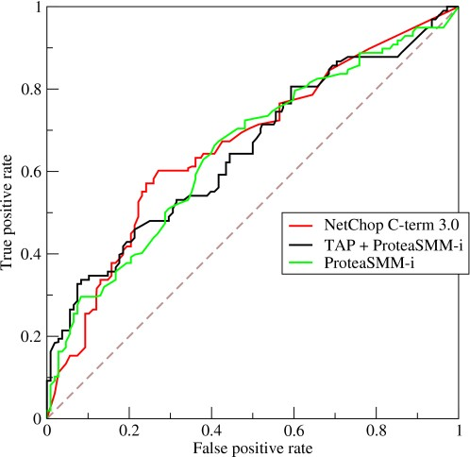
ROC Curve
Receiver Operating Characteristic Curve
Plot of true positive rate (recall) vs. false positive rate at various threshold settings.
Points above the diagonal represent good classification (better than random)
Ideal curve would just be a point in the upper-left corner
BOR at the English language Wikipedia [CC BY-SA 3.0 (http://creativecommons.org/licenses/by-sa/3.0/)]
The more it’s “bent” toward the upper-left, the better

Slide 176
AUC
The area under the ROC curve is… wait for it..
Area Under the Curve (AUC)
Equal to probability that a classifier will rank a randomly chosen positive instance higher than a randomly chosen negative one
ROC AUC of 0.5 is a useless classifier, 1.0 is perfect
Commonly used metric for comparing classifiers

Slide 177
The Bias / Variance Tradeoff

Slide 178
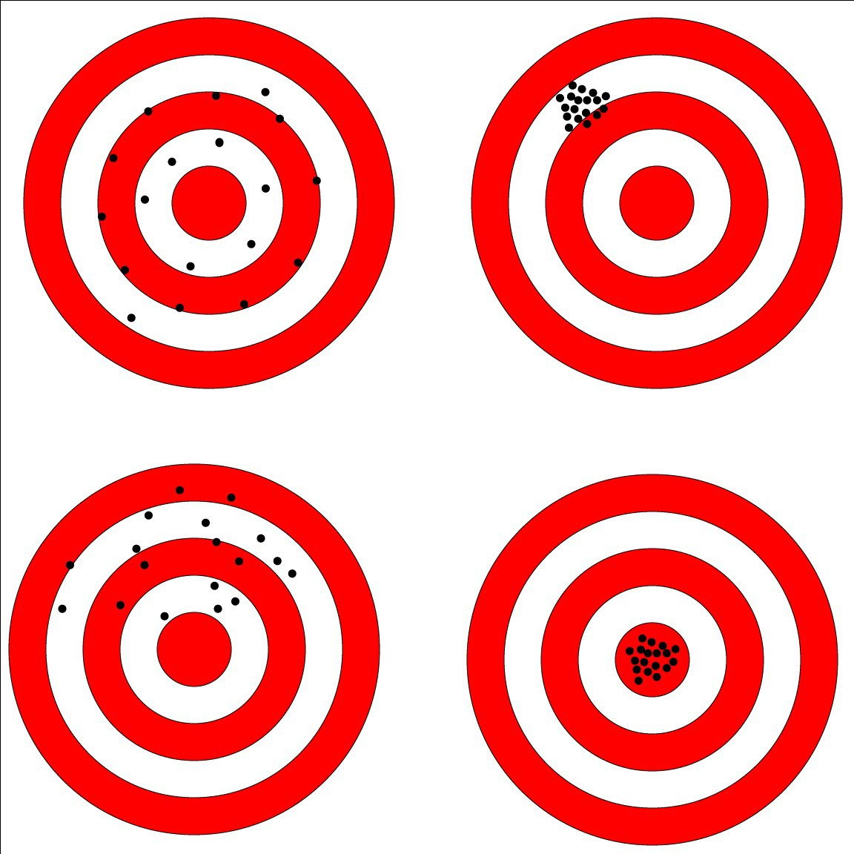
Bias and Variance
Bias is how far removed the mean of your predicted values is from the “real” answer
Variance is how scattered your predicted values are from the “real” answer
Describe the bias and variance of these four cases (assuming the center is the correct result)

Slide 179
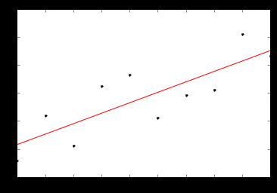
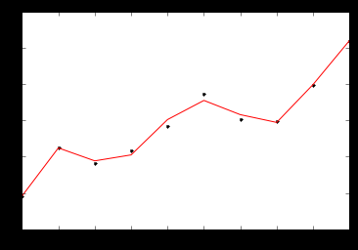
Often you need to choose between bias and variance
It comes down to overfitting vs underfitting your data

Slide 180
But what you really care about is error
Bias and variance both contribute to error
▫ 𝐸𝑟𝑟𝑜𝑟 = 𝐵𝑝𝑝𝑎𝑠² + 𝑉𝑎𝑟𝑝𝑝𝑎𝑛𝑐𝑒
But it’s error you want to minimize, not bias or variance specifically
A complex model will have high variance and low bias
A too-simple model will have low variance and high bias
But both may have the same error – the optimal complexity is in the middle

Slide 181
Tying it to earlier lessons
Increasing K in K-Nearest-Neighbors decreases variance and increases bias (by averaging together more neighbors)
A single decision tree is prone to overfitting – high variance
▫ But a random forest decreases that variance.

Slide 182
Avoiding Overfitting
Using K-Fold Cross Validation

Slide 183
Review: K-Fold Cross Validation
One way to further protect against overfitting is K-fold cross validation
Sounds complicated. But it’s a simple idea:
▫ Split your data into K randomly-assigned segments
▫ Reserve one segment as your test data
▫ Train on the combined remaining K-1 segments and measure their performance against the test set
▫ Repeat for each segment
▫ Take the average of the K r-squared scores
Prevents you from overfitting to a single train/test split

Slide 184
Using K-Fold Cross Validation
Scikit-learn makes this really easy. Even easier than just a single train/test split.
In practice, you need to try different variations of your model and measure the mean accuracy using K-Fold Cross validation until you find a sweet spot

Slide 185
Let’s Play
Use K-Fold Cross Validation with a SVC model of Iris classification. We’ll see that without K-Fold, we could overfit the model.

Slide 186
Cleaning Your Data

Slide 187
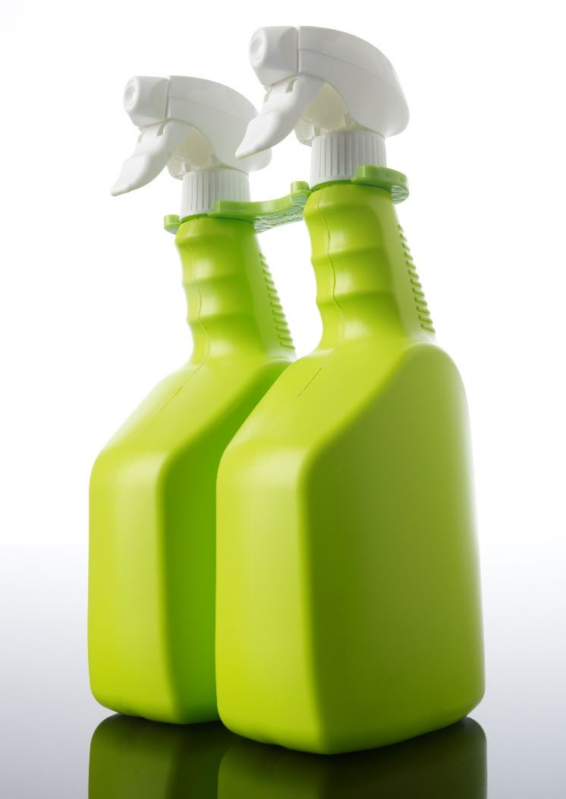
Cleaning your Data
The reality is, much of your time as a data scientist will be spent preparing and “cleaning” your data
▫ Outliers
▫ Missing Data
▫ Malicious Data
▫ Erroneous Data
▫ Irrelevant Data
▫ Inconsistent Data
▫ Formatting

Slide 188
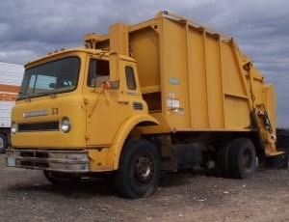
Garbage In, Garbage Out
Look at your data! Examine it!
Question your results!
▫ And always do this – not just when you don’t get a result that you like!

Slide 189

Let’s analyze some web log data.
All I want is the most-popular pages on my non-profit news website.
How hard can that be?

Slide 190
Normalizing Numerical Data

Slide 191
The importance of normalizing data
If your model is based on several numerical attributes – are they comparable?
▫ Example: ages may range from 0-100, and incomes from 0-billions
▫ Some models may not perform well when different attributes are on very different scales
▫ It can result in some attributes counting more than others
▫ Bias in the attributes can also be a problem.

Slide 192
Examples
Scikit-learn’s PCA implementation has a “whiten” option that does this for you. Use it.
Scikit-learn has a preprocessing module with handy normalize and scale functions
Your data may have “yes” and “no” that needs to be converted to “1” and “0”

Slide 193
Read the docs
Most data mining and machine learning techniques work fine with raw, un-normalized data
But double check the one you’re using before you start.
Don’t forget to re-scale your results when you’re done!

Slide 194
Dealing with Outliers

Slide 195

Dealing with Outliers
Sometimes it’s appropriate to remove outliers from your training data
Do this responsibly! Understand why you are doing this.
For example: in collaborative filtering, a single user who rates thousands of movies could have a big effect on everyone else’s ratings. That may not be desirable.
Another example: in web log data, outliers may represent bots or other agents that should be discarded.
But if someone really wants the mean income of US citizens for example, don’t toss out billionaires just because you want to.

Slide 196
Dealing with Outliers
Our old friend standard deviation provides a principled way to classify outliers.
Find data points more than some multiple of a standard deviation in your training data.
What multiple? You just have to use common sense.

Slide 197
Let’s play with some data.

Slide 198
Feature Engineering

